Slide 1
NodeJS
By: SUJEET SRIVASTAVA

Slide 2
Agenda
What is Real-time web
To create Real-time system on web we need ..
Some technologies for Real-time systems
Introduction NodeJS
What is NodeJS?
Why Use NodeJS ?
Two Important Theories
What is unique about Node.js?
What can you do with Node.js ?
What can’t do with Node.js?
Threads VS Event-driven
Why node.js use event-based?
System Requirements
Node.js VS Apache
What can we do with Node.js
When to use Node.js ?
System Requirements
lets play with Node - Demo
Drawbacks
Who is using Node.js
References

Slide 3
What is Real-time web
The meaning is that: users can see the contents as fast as the author publish it (like chat applications)
A lot of technologies are used to implement the Real-time systems.
Today I’m interested in a technology that do that for us in an easy, reliable, and fantastic way

Slide 4
To create Real-time system on web we need ..
Very fast web server.
Very very fast I/O operations (Non-blocking).
System that depend on event-driven(event-loops).
Flexible tool to handle all of this in a simple way.

Slide 5
Some technologies for Real-time systems
Python [ twisted ]
Ruby [ EventMachine ]
Perl [ AnyEvent ]
If you deal with one of them, this presentation will be really understood at once.

Slide 6
Introduction NodeJS
Node.js was created by Ryan Dahl starting in 2009, and its growth is sponsored by Joyent, his employer.
"Node is similar in design to and influenced by systems like Ruby's event machine or Python's twisted. Node takes the event model a bit further—it presents the event loop as a language construct instead of as a library."
Three Main Point:
Evented I/O for JavaScript
Server Side JavaScript
Run on Google V8 JavaScript Engine

Slide 7
What is NodeJS ?
In simple words Node.js is ‘server-side JavaScript’.
In not-so-simple words Node.js is a high-performance network applications framework, well optimized for high concurrent environments.
It’s Open Source. It runs well on Linux systems, can also run on Windows systems.
uses an asynchronous event-driven model.

Slide 8
What is NodeJS ?
A JavaScript runtime environment running Google Chrome’s V8 engine the same used by Google Chrome browser
a.k.a. a server-side solution for JS
Compiles JS, making it really fast
Runs over the command line
Designed for high concurrency
Without threads or new processes
Never blocks, not even for I/O
Uses the CommonJS framework
Making it a little closer to a real OO language

Slide 9
Why Use NodeJS ?
Node's goal is to provide an easy way to build scalable network programs.
Google V8 engine
V8 is an open source JavaScript engine developed by Google. It’s written in C++ and is used in Google Chrome Browser.
Faster than SpiderMonkey (used in firefox) over 4 times ( when V8 was invented ) ☺
- from an expert on stakoverflow -

Slide 10

Now I’m interested
in two important
theories applied in
Node.js

Slide 11
Theory 1 : Event-loops
Instead of threads Node uses an event loop with a stack
Alleviates overhead of context switching
Event-loops are the core of event-driven programming, almost all the UI programs use event-loops to track the user event, for example: Clicks, Ajax Requests etc.
Client
Clients send HTTP requests
to Node.js server
Event loop returns
result to client
Event loop
(main thread)
An Event-loop is woken up by OS,
passes request and response objects
to the thread-pool
Long-running jobs run
on worker threads
Response is sent
back to main thread
via callback
C++ Threadpool
(worker threads)

Slide 12
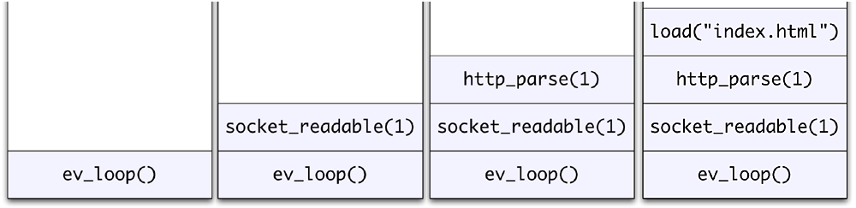
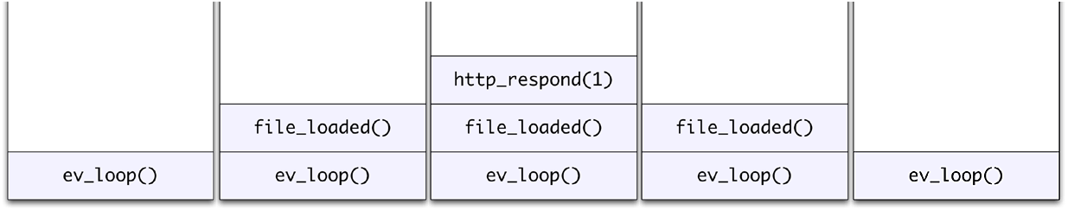
Event Loop Example
Request for “index.html” comes in
Stack unwinds and ev_loop goes to sleep
File loads from disk and is sent to the client

Slide 13
Theory 2 : Non-blocking I/O
Traditional I/O
var result = db.query(“select x from table_Y”);
doSomethingWith(result); //wait for result!
doSomethingWithOutResult(); //execution is blocked!
Non-traditional, Non-blocking I/O
db.query(“select x from table_Y”,function (result){
doSomethingWith(result); //wait for result!
});
doSomethingWithOutResult(); //executes without any delay!

Slide 14
What is unique about Node.js?
JavaScript used in client-side but node.js puts the JavaScript on server-side thus making communication between client and server will happen in same language
Servers are normally thread based but Node.JS is “Event” based. Node.JS serves each request in a Evented loop that can able to handle simultaneous requests.

Slide 15
What can you do with Node JS ?
It is a command line tool. You download a tarball, compile and install the source.
It lets you Layered on top of the TCP library is a HTTP and HTTPS client/server.
The JS executed by the V8 JavaScript engine (the ting that makes Google Chrome so fast)
Node provides a JavaScript API to access the network and file system.

Slide 16
What can’t do with NodeJS ?
Node is a platform for writing JavaScript applications outside web browsers. This is not the JavaScript we are familiar with in web browsers. There is no DOM built into Node, nor any other browser capability.
Node can’t run on GUI, but run on terminal

Slide 17
Threads VS Event-driven
Threads | Asynchronous Event-driven
Lock application / request with listener-workers threads | only one thread, which repeatedly fetches an event
Using incoming-request model | Using queue and then processes it
multithreaded server might block the request which might involve multiple events | manually saves state and then goes on to process the next event
Using context switching | no contention and no context switches
Using multithreading environments where listener and workers threads are used frequently to take an incoming-request lock | Using asynchronous I/O facilities (callbacks, not poll/select or O_NONBLOCK) environments

Slide 18
Why node.js use event-based ?
In a normal process cycle the webserver while processing the request will have to wait for the IO operations and thus blocking the next request to be processed.
Node.JS process each request as events, The server doesn’t wait for the IO operation to complete while it can handle other request at the same time.
When the IO operation of first request is completed it will call-back the server to complete the request.

Slide 19
Node.js VS Apache
It's fast
It can handle tons of concurrent requests
It's written in JavaScript (which means you can use the same code server side and client side)
Platform | Number of request per second
PHP ( via Apache) | 3187,27
Static ( via Apache ) | 2966,51
Node.js | 5569,30

Slide 20
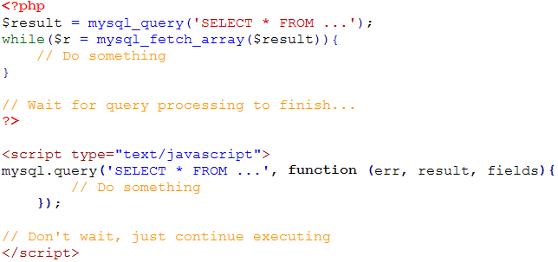
I/O Example

Slide 21
What can we do with Node.js
You can create an HTTP server and print ‘hello world’ on the browser in just 4 lines of JavaScript.
You can create a DNS server.
You can create a Web Chat Application like GTalk in the browser.
Node.js can also be used for creating online games, collaboration tools or anything which sends updates to the user in Real-time.

Slide 22
When to use Node.js ?
streaming based Real-time services, online games, web chat applications,..etc.
If you need high level concurrency and not worried about CPU-cycles.
If you are good at JavaScript code.
You will develop the front-end and back-end in the same language, what a triumph ☺

Slide 23
System Requirements
Node runs best on the POSIX-like operating systems. These are the various UNIX derivatives (Solaris, and so on) or work a likes (Linux, Mac OS X, and so on).
While Windows is not POSIX compatible, Node can be built on it either using POSIX compatibility environments (in Node 0.4x and earlier).

Slide 24
Ok, lets play with Node
Node JS
Example: Creating Http server

Slide 25
Drawbacks
Use of JS on both the client and server-side should remove need to “context switch”
Client-side JS makes heavy use of the DOM, no access to files/databases
Server-side JS deals mostly in files/databases, no DOM
JSDom project for Node works for simple tasks, but not much else

Slide 26
Conclusion
Non-blocking nature takes some getting used to
Interesting API
Can almost remake Dash!
Node.js faster than apache but it more hungry system’s CPU and memory
Node.js use event based programming, it make the server doesn’t wait for the IO operation to complete while it can handle other request at the same time

Slide 27






Who is using Node.js
Complete list can be found at: https://github.com/joyent/node/wiki/Projects,-Applications,-and-Companies-Using-Node

Slide 28
References
http://nodejs.org/
http://nodejs.org/cinco_de_node.pdf
http://ajaxian.com/archives/google-chrome-chromium-and-v8
http://blog.chromium.org/2010/12/new-crankshaft-for-v8.html
http://news.softpedia.com/news/IE9-RC-vs-Chrome-10-9-vs-Opera-11-vs-Firefox-11-Performance-Comparison-183973.shtml

Slide 29
Thanks
Sujeet Srivastava
Twitter: @sujeetsrivastava

